Slide 1

Confidential and Proprietary. Copyright (c) by Gotcha. All Rights Reserved

Slide 2

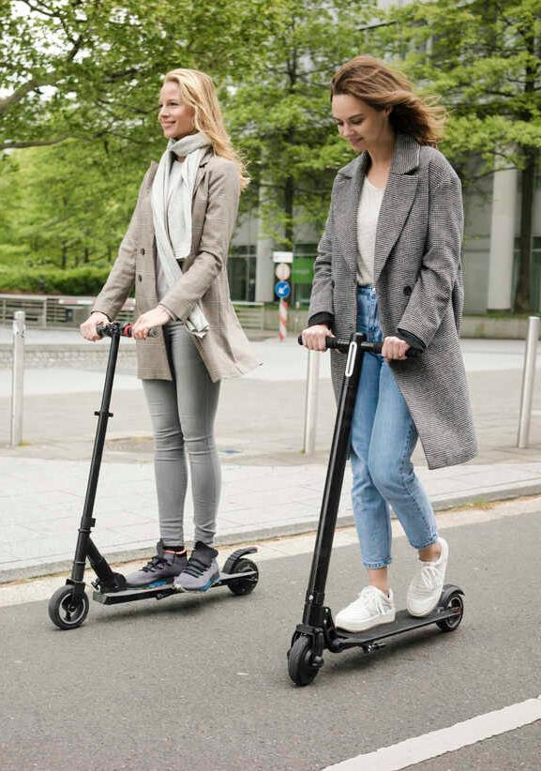









THE MICROMOBILITY REVOLUTI0N
Air pollution
Lack of parking spots
Rising gas prices
Comfortable
Low-cost
Available
Confidential and Proprietary. Copyright (c) by Gotcha. All Rights Reserved

Slide 3
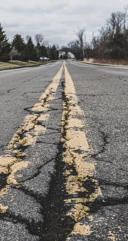



THE PROBLEM
70%
200,000
injured in the last 4 years in the USA
increase in the number of casualties in the USA between 2018-2022
73.5%
of the accidents occurred using rented vehicles
15%
5,000
of all accidents in Israel involve micromobility
people got to Ichilov Hospital during last year
Confidential and Proprietary. Copyright (c) by Gotcha. All Rights Reserved

Slide 4




THE PROBLEM
G
Gotcha
Injuries per 1M trips
Rental e-scooters users safety sense
Not sure
2%
200
15
Unsafe
41%
8
Safe
57%
104
B. Walch, L. Martin, S. Turner - Micromobility risk study
Confidential and Proprietary. Copyright (c) by Gotcha. All Rights Reserved

Slide 5
THE PROBLEM
G
Gotcha
But Why?
80% of accidents involving e-scooters are against non-moving object
Potholes
Behavioral
Other
40%
50%
10%
B. Walch, L. Martin, S. Turner - Micromobility risk study
Confidential and Proprietary. Copyright (c) by Gotcha. All Rights Reserved

Slide 6







MEET GOTCHA
11:34
5G
Connect with
G
G
or
Confidential and Proprietary. Copyright (c) by Gotcha. All Rights Reserved

Slide 7

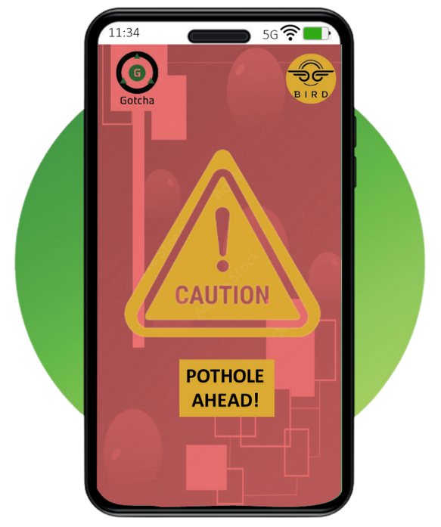
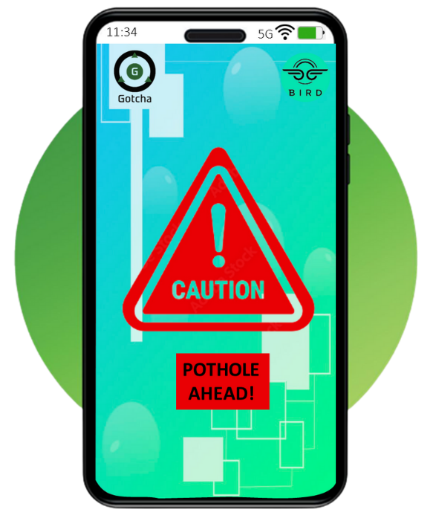
MEET GOTCHA
G
Gotcha
Confidential and Proprietary. Copyright (c) by Gotcha. All Rights Reserved

Slide 8
MEET GOTCHA
G
Gotcha
Confidential and Proprietary. Copyright (c) by Gotcha. All Rights Reserved

Slide 9
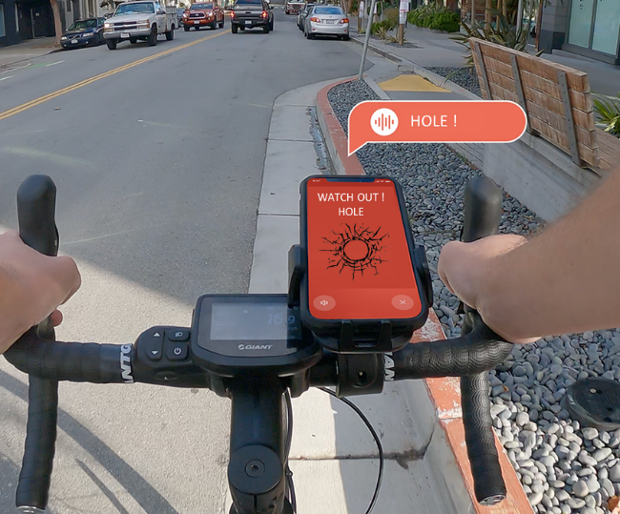
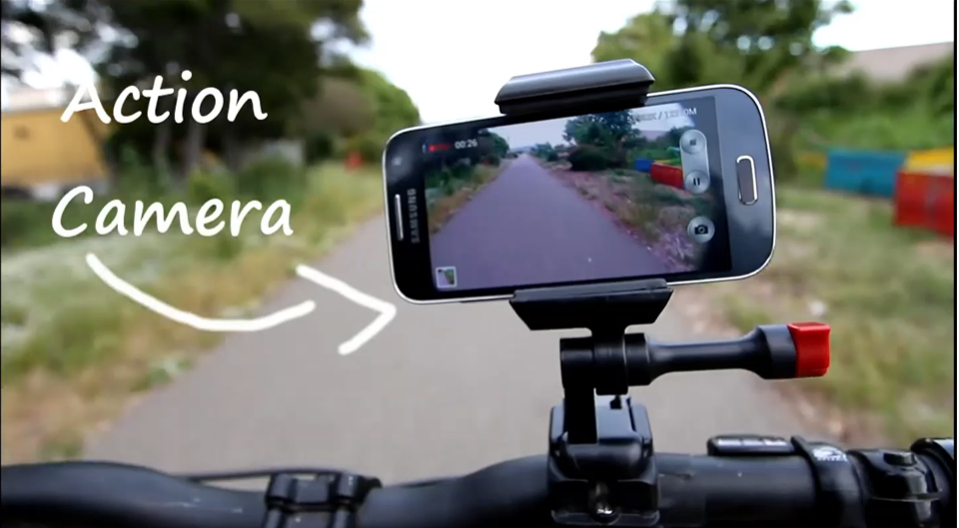



MEET GOTCHA
G
Gotcha
An alert system for e-scooter riders
Defects on the
road alerts
Confidential and Proprietary. Copyright (c) by Gotcha. All Rights Reserved

Slide 10
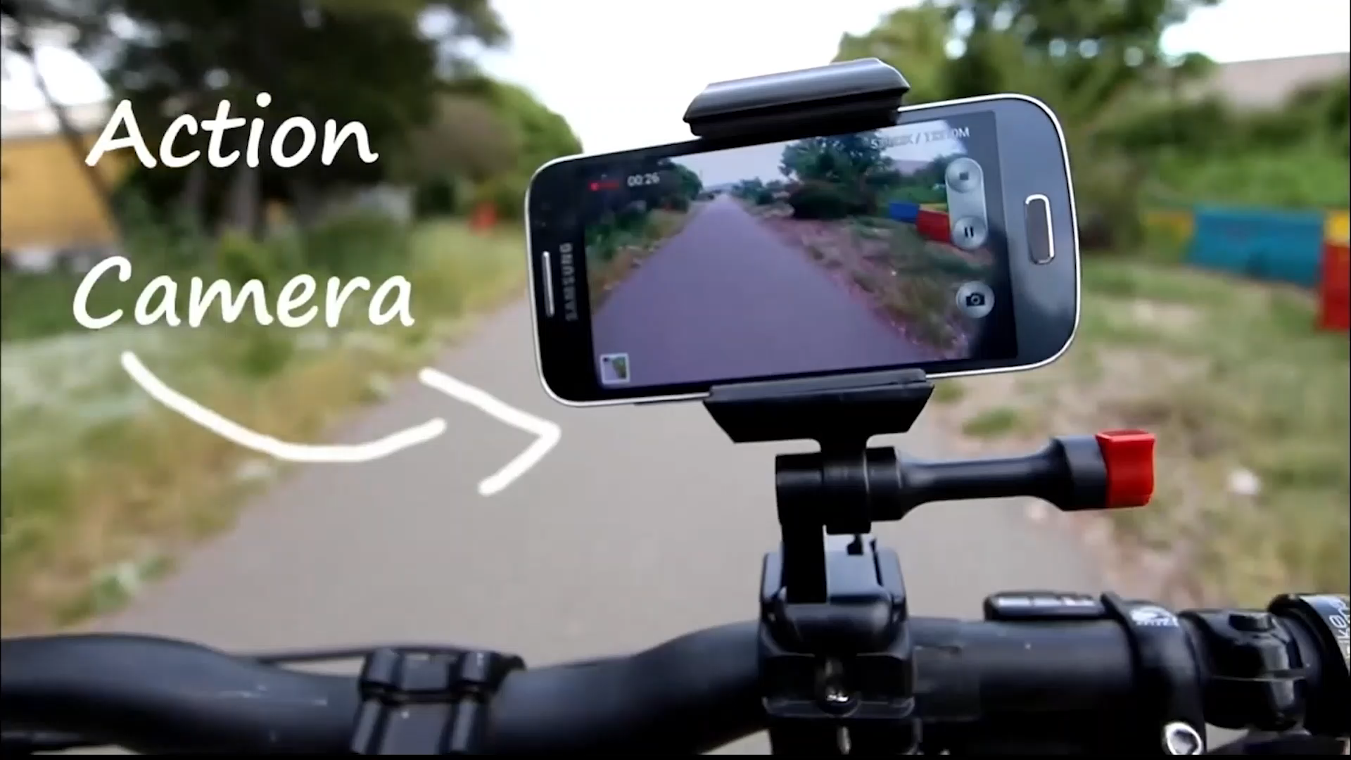

Slide 11
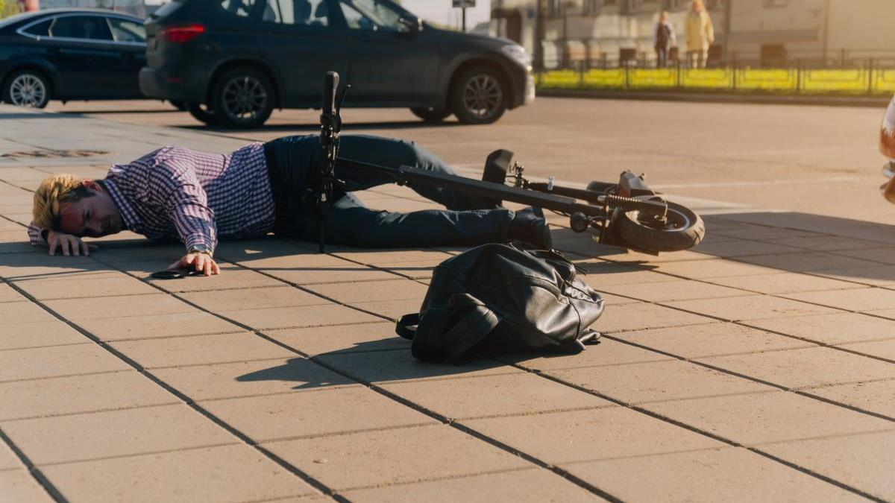
HELP US SAVE LIVES
Confidential and Proprietary. Copyright (c) by Gotcha. All Rights Reserved

